Slide 1
Architecture, Components and real-world applications of Arduino

Slide 2
Introduction to Arduino
Arduino is an open-source hardware and software company, project and user community that designs and manufacture single-board microcontrollers and microcontroller kits for building digital devices.
It is an open-source electronics prototyping platform based on easy-to-use hardware and software.
Arduino is written in C++ with some additional of specific methods and functions.
Arduino is simple a programmable microcontroller. It does not have RTOS when compared to other computer systems.
There are variety of Arduino boards such as Arduino UNO, Arduino Nano, Arduino Mega, e.t.c

Slide 3
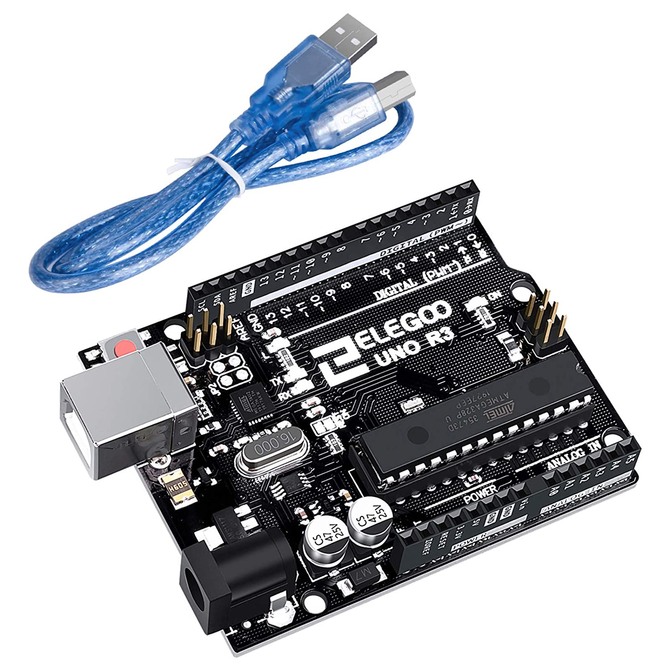

Slide 4
Arduino Architecture
Simply, Arduino's processor uses the Harvard architecture where the program code and program data have separate memory.
It consists of two memory namely Program memory and Data memory.
The code is stored in the flash memory, whereas the data is stored in the data memory.
The Harvard architecture allows more that one memory transaction simultaneously through the use of two memory spaces.

Slide 5
Arduino Architecture Cont ...
In the Harvard architecture the un-occupied data memory cannot be used by instructions and the free instructions cannot be used by data.
Memory dedicated to each unit has to be balanced carefully.
Harvard architecture is primarily for small embedded systems and signal processing.
A Harvard architecture system can be thus faster for a given circuit complexity because instruction fetches and data access do not contend for a single memory pathway.
Also the Harvard architecture has distinct code and data address spaces meaning address zero is not the same as data address zero.

Slide 6
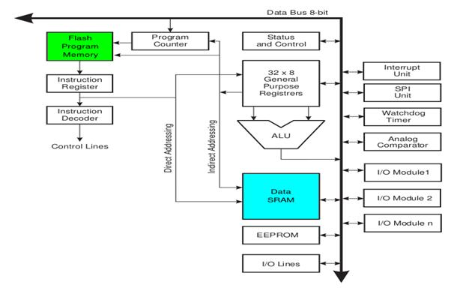

Slide 7
PROGRAM MEMORY
PM Address bus
DSP CORE
DM Address bus
DATA MEMORY
PM Data bus
DM Data bus

Slide 8
Arduino Components
The major components of Arduino UNO board are as follows:
USB Connector
Power port
Microcontroller
Analog input and Digital pins
Reset switch
Crystal oscillator
USB interface chip
TX RX LEDs

Slide 9
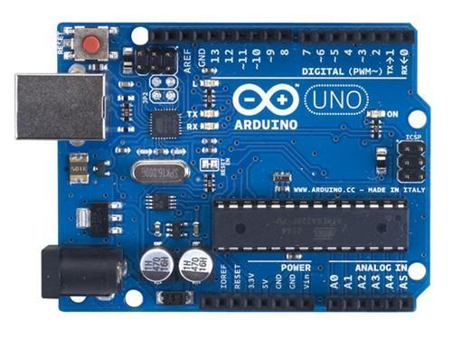

Slide 10
Real-world Applications of Arduino
With the Arduino board we can control the Home, Office and Industrial activities with the control systems such as motion sensors, outlet control, temperature sensors, blower control, garage door control, air flow control and many others.
Arduino can be used in many industrial control and automation systems.
Using different top technologies like AI, ML, IoT and many others, we can interface an Arduino board to produce more and more intelligent devices and systems.
Arduino is an open-source, it is just an electronics prototyping board.

Slide 11
Must-have Tools ….
Simulation software (e.g Proteus, Fritzing)
Circuit designing tools (e.g Fritzing, Proteus, LibrePCB)
Arduino IDE (very important)
Arduino Kit

Slide 12
Simulation of Arduino Projects
A number of tools are used to simulate Arduino circuits
Proteus Profession configured with Arduino Libraries
Licensed Fritzing
Online tools such as Tinkercad from https://www.tinkercad.com
Blinking an LED.

Slide 13


